Slide 1

Simplify .Your(Automated.Tests) .With(Fluent.Syntax)
«Zusammen MehrWert»
Filialmeeting 23.11.2021

Slide 2
Content
Example
What
Why
How
Do’s & Don’ts
More .NET Code Samples

Slide 3

Example

Slide 4
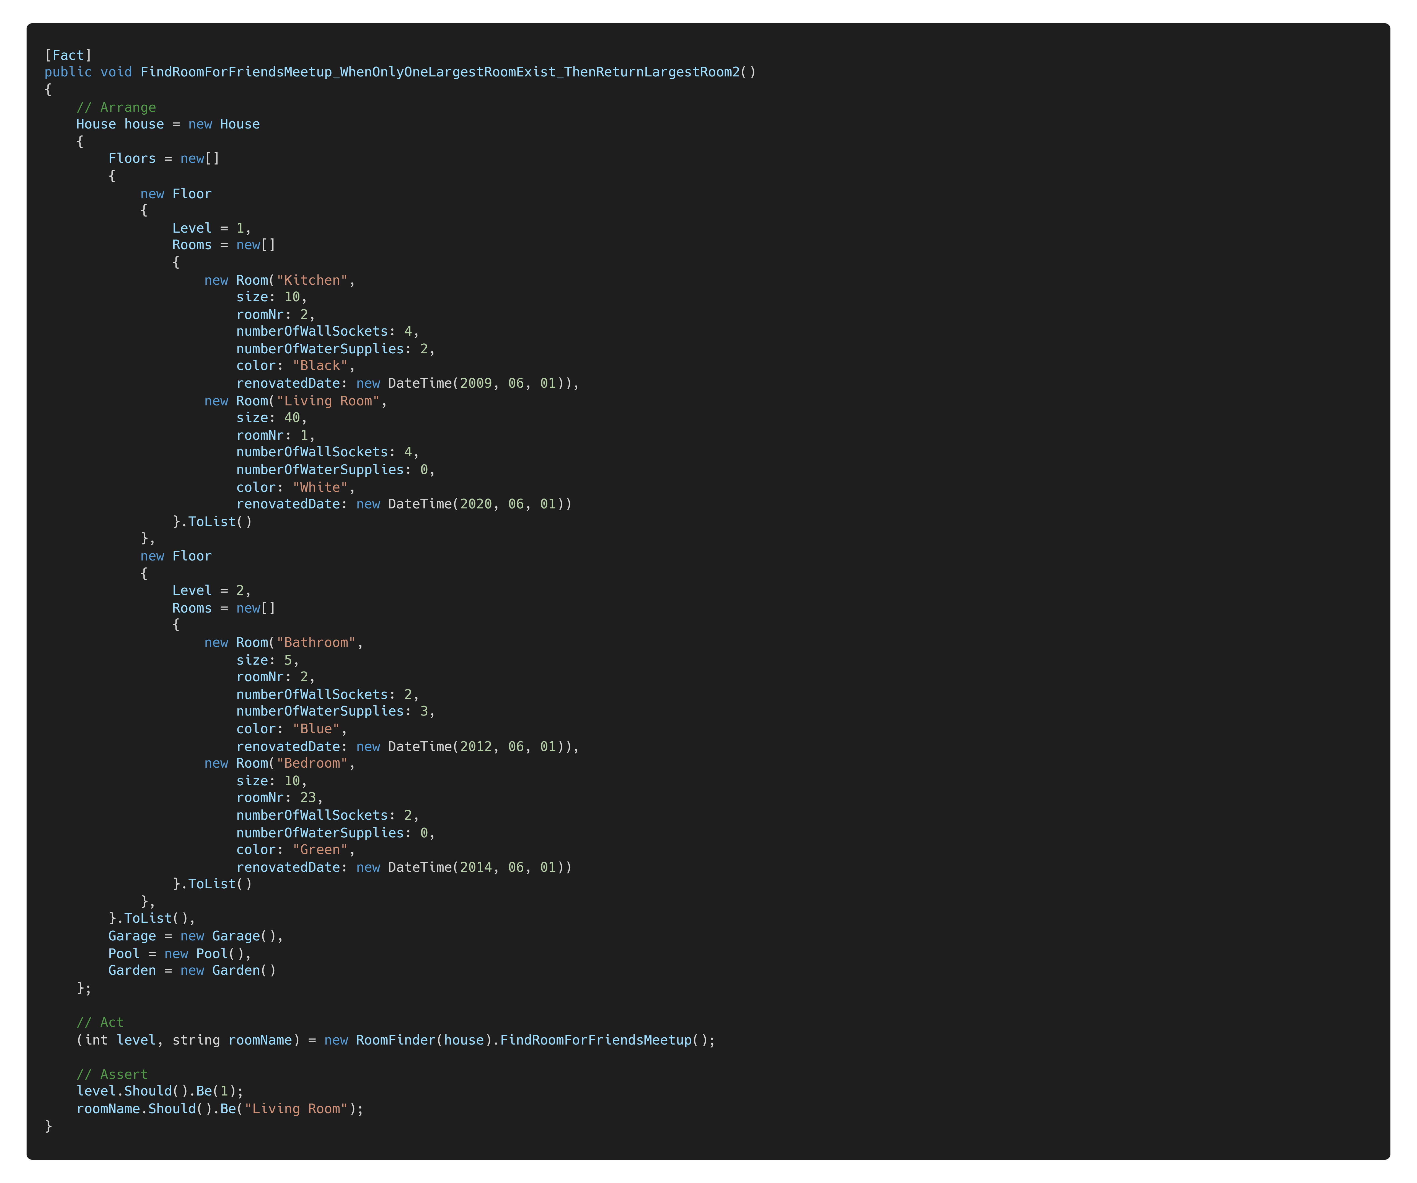

Without Fluent Syntax
Notes:
Switch to IDE. Show large test.
https://carbon.now.sh/nPIJ2FX2mlz5QKcSxInP

Slide 5
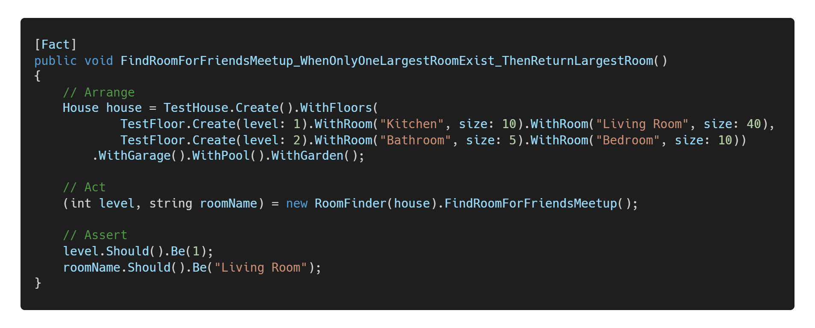
With Fluent Syntax
Notes:
https://carbon.now.sh/HOkxueZRJprR76cYCTzf

Slide 6
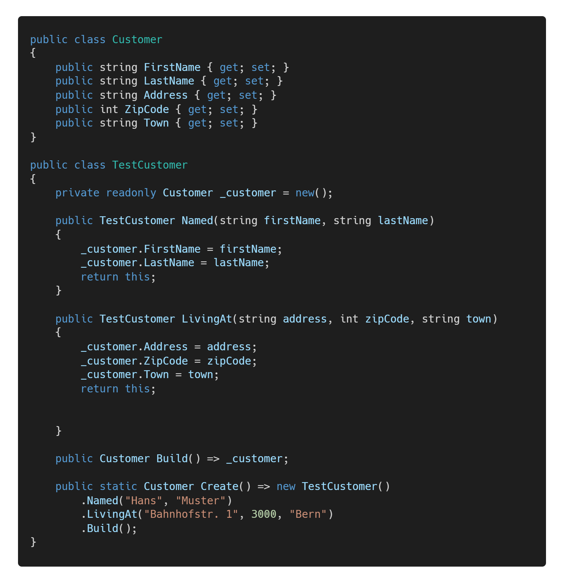
What do I mean with "Fluent Syntax"?
Fluent interface, Fluent API, Test API
An API using method chaining and the builder pattern (returning ‘this’)
Goals:
write in natural human language
make the code more domain-specific (DSL)
decouple creation from the object/data itself
Popular libraries:
C# LINQ/FluentAssertions
Java Steam API/AssertJ
Javascript jQuery/Jasmine...
Notes:
I'm also mentioning some other best practices for tests without Fluent Syntax.
https://carbon.now.sh/zDtsRMfvpfwTueRan8vu

Slide 7
“Remove everything that has no relevance to the story. If you say in the first chapter that there is a rifle hanging on the wall, in the second or third chapter it absolutely must go off. If it’s not going to be fired, it shouldn’t be hanging there.” Anton Chekhov, Russian Writer

Slide 8
Chekhov's Gun
Everything within the body of a test should be important and influence the code path being tested
Everything else will make the tests noisy and hard to understand.
BUT: Do not hide any important values (e.g. level: GetLevel())
Notes:
What it means for automated software tests:
Everything (all visible values or method calls) within the body of a test should be important and influence the code path being tested
room name
size
level
Everything else will make the tests noisy and hard to understand.
roomNr
renovatedDat
BUT: Do not hide any important values in helper method/field initializer/ctor/class (e.g. level: GetLevel())

Slide 9

Advantages of a Test API / Fluent Syntax
Using productive code is different in tests
Prevents changes from productive code refactoring
Readability(test code) = Readability(productive code)
Our convention: max 1 screen height/test
Notes:
Using productive code is different:
because you need to mock/fake some dependencies.
Abstraction Layer prevents changes from productive code refactoring
Readability(test code)= Readability(productive code)
Our convention: max 1 screen height/test

Slide 10
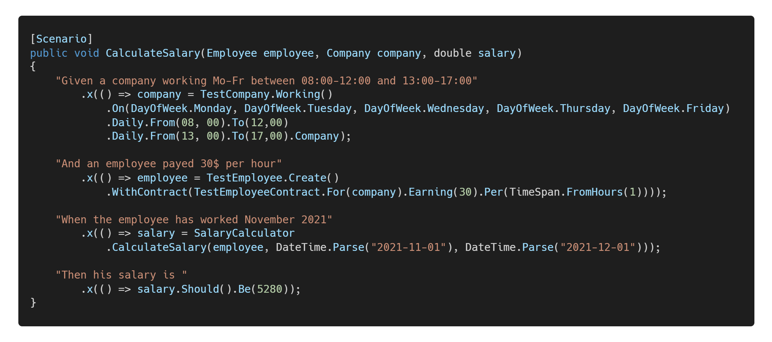
Acceptance Tests with Fluent Syntax
Notes:
There aren’t only unit tests.
Tests with different granularity/level (Algorithm, Group of classes, Component, UI…)
Example (Salary Calculator) with xBehave Integration Tests/Acceptance Tests
Domain-specific human language
Specifies the expected software behaviour
Looks like "coded" acceptance criteria
Fluent Tests support the approach of
Behaviour Driven Development
Acceptance test–driven development (ATDD).
The implementation of Given/When/Then steps could be written in place with the step definition
Makes it easier to discuss with your team members (or even Stakeholders?)
Living documentation of your system (Specification by example)
https://carbon.now.sh/oz94KmohxEMqbSwyBZVD

Slide 11
Fluent Tests and ATDD
Domain-specific human language
Specifies the expected software behaviour
Looks like "coded" acceptance criteria
Fluent Tests support the approach of
Behaviour Driven Development
Acceptance test–driven development (ATDD).
The implementation of Given/When/Then steps could be written in place with the step definition
Makes it easier to discuss with your team members (or even Stakeholders?)
Living documentation of your system (Specification by example)

Slide 12

How to write better tests
Notes:
https://github.com/appgemacht/SimplifyYourUnitTestsWithFluentSyntax#how-to-write-better-tests

Slide 13

In “Massen” geniessen
Notes:
Use it as much as necessary, as little as possible!

Slide 14
Do’s and Don’ts
Good fluent APIs take a while to build.
Too complex test helpers can lead to bugs in test code
Try to improve your productive code, so you don’t even need test helpers
If your productive classes are bags with getters and setters, named “DTOs”
See AnemicDomainModel.
Prefer object-oriented over procedural style
For legacy code:
Create Tests and Test Helpers around it
Refactor productive code step by step, so you can remove the Test Helpers
Notes:
Good fluent APIs take a while to build.
Too complex test helpers can lead to bugs in test code
Try to improve your productive code, so you don’t even need test helpers
use appropriate constructors or factory methods.
validate parameter values and ensure the object is always consistent.
make properties immutable if possible.
One goal of Test First/TDD
improve the design of your classes.
instead of the design of your Fluent API
If your productive classes are mutable bags with getters and setters, named “DTOs”
See AnemicDomainModel.
Put more behaviour into your domain objects.
Prefer object-oriented over procedural style
For legacy code:
Create Tests and Test Helpers around it
Refactor productive code step by step, so you can remove the Test Helpers

Slide 15
More Code Samples

Slide 16
Thank you
Jean-Marc Vogel
Software Engineer .NET
github.com/appgemacht

